Slide 1

An Introduction to The Formal Development and Verification of Software with Event-B/ RODIN Event-B)
Mike Poppleton
users.ecs.soton.ac.uk/mrp
Slides adapted from Prof. Michael Butler,
Marktoberdorf Summer School 2012

Slide 2
Session 1: Problem Abstraction and Model Refinement - An Overview
This afternoon:
Session 2: Verification and tools in Event-B modelling
Session 3: Case study: the cardiac pacemaker

Slide 3
Overview
Motivation
difficulty of discovering errors / cost of fixing errors
Small pedagogical example (access control)
abstraction
refinement
automated analysis
Background on Event-B formal method
Methodological considerations

Slide 4
Cost of fixing requirements errors
“Extra Time Saves Money”
Warren Kuffel
Computer Language
December 1990
Notes:
Investment opportunity

Slide 5
Cost of error fixes grows - difficult to change this
Cost
of fix
Reqs
Spec
Design
Impl
Test
& fix
Accept
testing
Deploy
Time of error discovery

Slide 6
Rate of error discovery
Error
discovery
rate
Reqs
Spec
Design
Impl
Test
& fix
Accept
testing
Deploy
Time of error discovery

Slide 7
Invert error identification rate?
Error
discovery
rate
Reqs
Spec
Design
Impl
Test
& fix
Accept
testing
Deploy
Time of error discovery

Slide 8
So, what’s wrong with the V model?
Specification
Validation testing
Preliminary design
Integration testing
Detailed design
Unit testing
Coding

Slide 9
So, what’s wrong with the V model?
Specification
Validation testing
Preliminary design
Integration testing
Many specification errors are detected
only after a lot of development has been undertaken
Unit testing
Detailed design
Coding

Slide 10
Why is it difficult to identify errors?
Lack of precision
ambiguities
inconsistencies
Too much complexity
complexity of requirements
complexity of operating environment
complexity of designs

Slide 11
Need for precise models/blueprints
Early stage analysis
Precise descriptions of intent
Amenable to analysis by tools
Identify and fix ambiguities and inconsistencies as early as possible
Mastering complexity
Encourage abstraction
Focus on what a system does
Early focus on key / critical features
Incremental analysis and design: separation of concerns

Slide 12
Correctness-by-construction using Formal Methods
Mathematical techniques for formulation and analysis of systems
Formal methods facilitate:
Clear specifications (contract)
Rigorous validation and verification
Validation: does the contract specify the right system?
answered through judgement
Verification: does the finished product satisfy the contract?
can be answered formally

Slide 13
Early stage analysis
Validation
Specification
Validation testing
Validation
Verification
Architectural design
Integration testing
Validation
Verification
Detailed design
Unit testing
Verification
Coding

Slide 14
Rapid prototying versus modelling
Rapid prototying: provides early stage feedback on system functionality
Plays an important role in getting user feedback
and in understanding some design constraints
But we will see that formal modelling and proof provide a deep understanding that is hard to achieve with rapid prototyping
Advice: use any approach that improves design process!

Slide 15
Rational design, by example
Example: access control system
Example intended to give a feeling for:
problem abstraction
modelling language
model refinement
role of verification and Rodin tool

Slide 16
Important distinction
Program Abstraction:
Automated process based on a formal artifact (program)
Purpose is to reduce complexity of automated verification
Problem Abstraction:
Creative process based on informal requirements
Purpose is to increase understanding of problem

Slide 17
Access control requirements
Users are authorised to engage in activities
User authorisation may be added or revoked
Activities take place in rooms
Users gain access to a room using a one-time token provided they have authority to engage in the room activities
Tokens are issued by a central authority
Tokens are time stamped
A room gateway allows access with a token provided the token is valid

Slide 18
Access control requirements
Users are authorised to engage in activities
User authorisation may be added or revoked
Activities take place in rooms
Users gain access to a room using a one-time token provided they have authority to engage in the room activities
Tokens are issued by a central authority
Tokens are time stamped
A room gateway allows access with a token provided the token is valid

Slide 19
Entities and relationships
USER
authorised
ACTIVITY
ROOM
takeplace
location
holder
room
TOKEN
manage
guards
authorise
manage
GATEWAY
read
issuer
AUTHORITY
trust
Notes:
Satisfies precision but what about complexity?
Who thinks this is not too complex?
Who thinks this is too complex?
In what sense might this be too complex?
Number of edges is potentially polynomial.
Graph with N nodes has (N.(N+1)) / 2

Slide 20
Entities and relationships
USER
authorised
ACTIVITY
ROOM
takeplace
location
holder
room
This model is unnecessarily complex to specify the main access control policy
TOKEN
manage
guards
authorise
manage
GATEWAY
read
issuer
AUTHORITY
trust

Slide 21
Extracting the essence
Purpose of our system is to enforce an access control policy
Access Control Policy: Users may only be in a room if they are authorised to engage in all activities that may take place in that room
To express this we only require Users, Rooms, Activities and relationships between them
Abstraction: focus on key entities in the problem domain related to the purpose of the system

Slide 22
Entities and relationships
USER
authorised
ACTIVITY
ROOM
takeplace
location
holder
room
TOKEN
manage
guards
authorise
manage
GATEWAY
read
issuer
AUTHORITY
trust

Slide 23
Abstract by removing entities
USER
authorised
ACTIVITY
ROOM
takeplace
location
Relationships represented in Event-B
authorised ∈ USER ↔ ACTIVITY // relation
takeplace ∈ ROOM ↔ ACTIVITY // relation
location ∈ USER ⇸ ROOM // partial function
Notes:
Diagram is a ‘natural’ way to construct (and present) this data model.

Slide 24
Access control invariant
∀u,r . u ∈ dom(location) ∧
location( u ) = r
⇒
takeplace[ r ] ⊆ authorised[ u ]
if user u is in room r,
then u must be authorised to engaged in
all activities that can take place in r

Slide 25
State snapshot as tables
USER | ACTIVITY
u1 | a1
u1 | a2
u2 | a2
ROOM | ACTIVITY
r1 | a1
r1 | a2
r2 | a1
r2 | a2
authorised
takeplace
USER | ROOM
u1 | r2
u2 | r1
u3
location
Notes:
Easy to check individual snapshots satisfy invariants
But we want to reason about all reachable snapshots
So we need to consider whether the events that cause transitions maintain invariants

Slide 26
Event for entering a room
Enter(u,r) ≙
when
grd1 : u ∈ USER
grd2 : r ∈ ROOM
grd3 : takeplace[ r ] ⊆ authorised[ u ]
then
act1 : location(u) := r
end
Does this event maintain the access control invariant?

Slide 27
Role of invariants and guards
Invariants: specify properties of model variables that should always remain true
violation of invariant is undesirable (safety)
use (automated) proof to verify invariant preservation
Guards: specify enabling conditions under which events may occur
should be strong enough to ensure invariants are maintained by event actions
but not so strong that they prevent desirable behaviour (liveness)

Slide 28
Remove authorisation
RemoveAuth(u,a) ≙
when
grd1 : u ∈ USER
grd2 : a ∈ ACTIVITY
grd3 : u ↦ a ∈ authorised
then
act1 : authorised := authorised ∖ { u ↦ a }
end
Does this event maintain the access control invariant?
Notes:
----- Meeting Notes (16/09/2012 12:36) -----
event leave
any u r
where
@grd3 u ↦ r ∈ location
then
@act1 location ≔ {u} ⩤ location
end

Slide 29
Counter-example from model checking

Slide 31
Failing proof

Slide 32
Strengthen guard of RemAuth
Notes:
----- Meeting Notes (16/09/2012 12:29) -----
note
----- Meeting Notes (16/09/2012 12:45) -----
// @grd4 ∀rr·u ↦ rr ∈ location ⇒ rr ↦ a ∉ takeplace

Slide 33
Early stage analysis
We constructed a simple abstract model
Already using verification technology we were able to identify errors in our conceptual model of the desired behaviour
we found a solution to these early on
verified the “correctness” of the solution
Now, lets proceed to another stage of analysis…

Slide 34
We construct a new model (refinement)
USER
authorised
ACTIVITY
location
holder
ROOM
takeplace
TOKEN
room
Guard of abstract Enter event:
grd3: takeplace[ r ] ⊆ authorised[ u ]
is replaced by a guard on a token:
grd3b: t ∈ valid ∧ room(t) = r ∧ holder(t) = u
Notes:
Akin to Manfred’s air bag example:
Abstract: crash => activate airbag
Concrete: crash sensor signal => activate bag

Slide 35
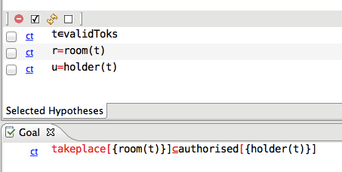
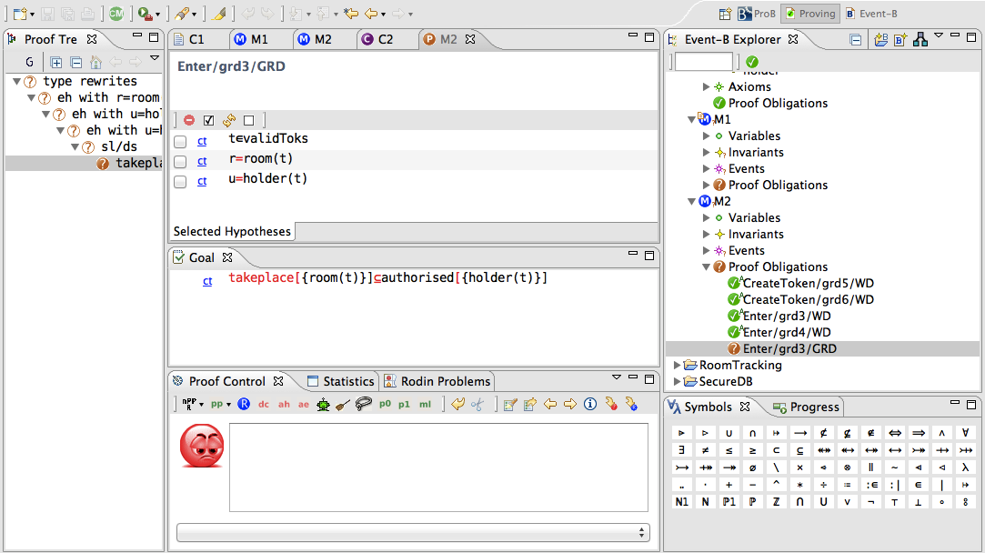
Failing refinement proof
Notes:
What to do: cf Ernie: ask Hillel, Talmundic scholar

Slide 36
Gluing invariant
USER
authorised
ACTIVITY
location
holder
ROOM
takeplace
TOKEN
room
To ensure consistency of the refinement we need invariant:
inv 6: t ∈ valid
⇒
takeplace [ room(t) ] ⊆ authorised[ holder(t) ]

Slide 37
Invariant enables PO discharge

Slide 38
But get new failing PO

Slide 39
Strengthen guard of refined RemAuth

Slide 40
Requirements revisited
Users are authorised to engage in activities
User authorisation may be added or revoked
Activities take place in rooms
…
Question: was it obvious initially that revocation of authorisation was going to be problematic?
Notes:
Formal modelling + verification allows you to become a domain expert quite quickly

Slide 41
Rational design – what, how, why
What does it achieve?
if user u is in room r,
then u must be authorised to engaged in
all activities that can take place in r
How does it work?
Check that a user has a valid token
Why does it work?
For any valid token t, the holder of t must be authorised to engage in all activities that can take place in the room associated with t

Slide 42
What, how, why written in Event-B
What does it achieve?
inv1: u∈dom(location) ∧ location( u ) = r
⇒
takeplace[ r ] ⊆ authorised[ u ]
How does it work?
grd3b: t ∈ valid ∧ r = room(t) ∧ u = holder(t)
Why does it work?
inv2: t ∈ valid
⇒
takeplace [ room(t) ] ⊆ authorised[ holder(t) ]
Notes:
Formal modelling literature tends to focus on what and how – why is important as well
NB inv2 was uncovered through proof

Slide 43
B Method (Abrial, from 1990s)
Model using set theory and logic
Analyse models using proof, model checking, animation
Refinement-based development
verify conformance between higher-level and lower-level models
chain of refinements
Code generation from low-level models
Commercial tools, :
Atelier-B (ClearSy, FR) - used mainly in railway industry
B-Toolkit (B-Core, UK, Ib Sorensen)

Slide 44
B evolves to Event-B (from 2004)
B Method was designed for software development
Realisation that it is important to reason about system behaviour, not just software
Event-B is intended for modelling and refining system behaviour
Refinement notion is more flexible than B
Same set theory and logic
Rodin tool for Event-B (V1.0 2007)
Open source, Eclipse based, open architecture
Range of plug-in tools

Slide 45
System level reasoning
Examples of systems modelled in Event-B:
Train signalling system
Mechanical press system
Access control system
Air traffic information system
Electronic purse system
Distributed database system
Cruise control system
Processor Instruction Set Architecture
…
System level reasoning:
Involves abstractions of overall system not just software components

Slide 46
Other Lectures
Verification and tools in Event-B modelling
Case study: the cardiac pacemaker

Slide 47
Rodin Demo
Access Control Example

Slide 48
END

